Slide 1

Course Id :INT 213

Slide 2
Recursion
Recursion is a useful technique borrowed from mathematics.
Recursive code is generally shorter and easier to write than iterative code. Generally, loops are turned into recursive functions when they are compiled or interpreted.
Recursion is most useful for tasks that can be defined in terms of similar subtasks. For example, sort, search, and traversal problems often have simple recursive solutions.

Slide 3
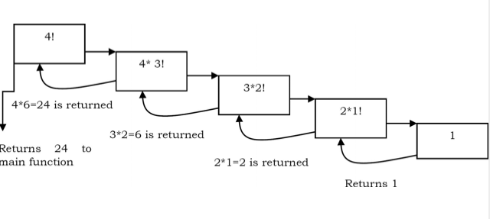
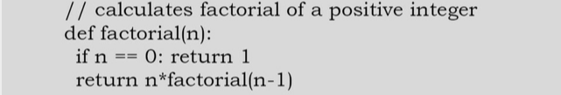
Recursion

Slide 4
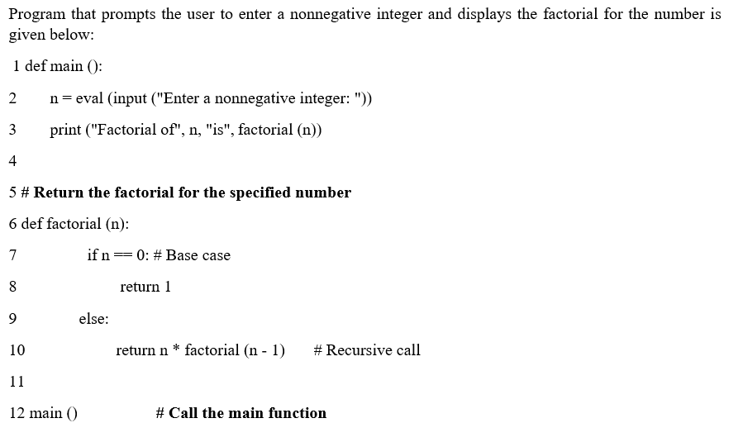
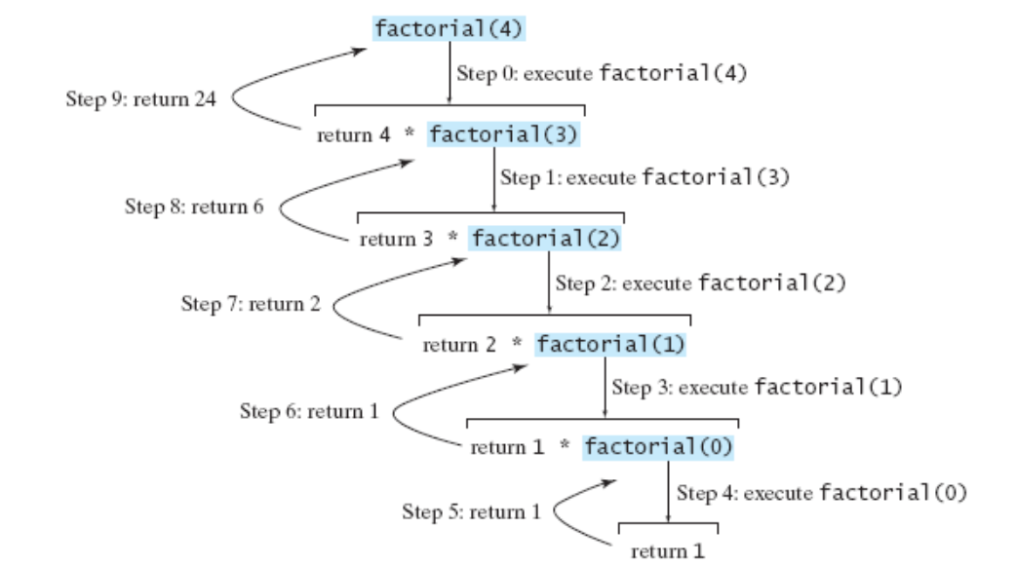
How program executed using recursion?

Slide 5
Tail Recursion
Tail recursion is a special case of recursion in which the last operation of a function is a recursive call.
In tail recursive function, there are no pending operations to be performed on return from a recursive call.

Slide 6
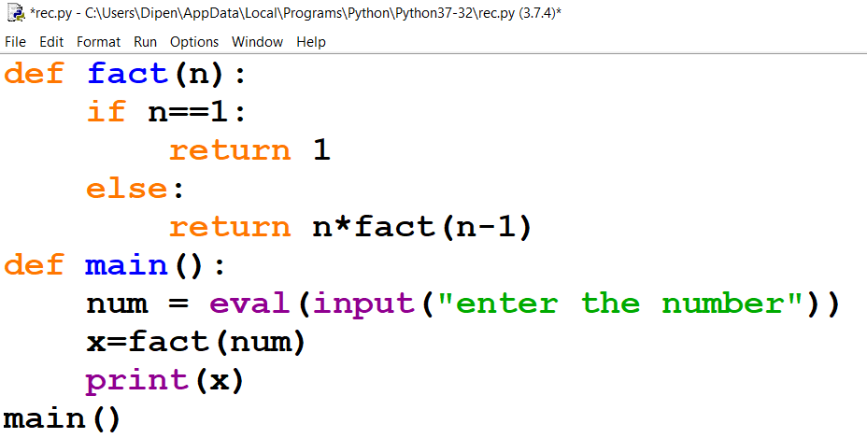
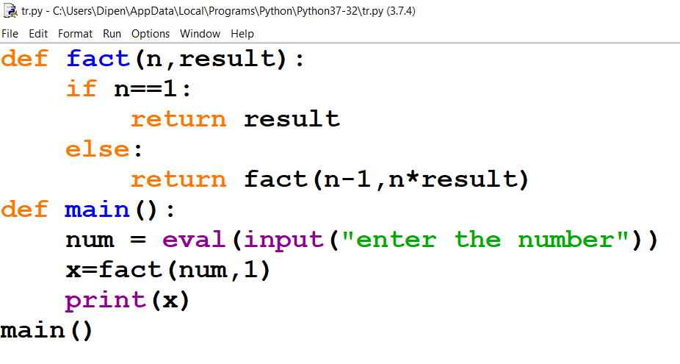
Normal Recursion Vs Tail Recursion
(Factorial of a number)
Normal Recursion
Tail Recursion

Slide 7
How to convert a non tail recursive function into a tail recursive function?
A non tail recursion function can be converted to a tail recursive function by adding one or more auxiliary parameters .
For example, result is added as an auxiliary parameter in the definition of function fact in the previous example.

Slide 8
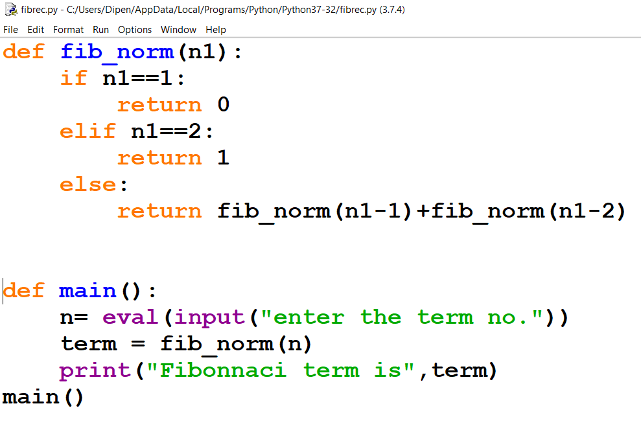
Fibonacci series:0 1 1 2 3 5 8 13 21 …………
Enter the term number(for example term number of 0 is 1,2 is 4……..) in output we will have the number at that location

Slide 9
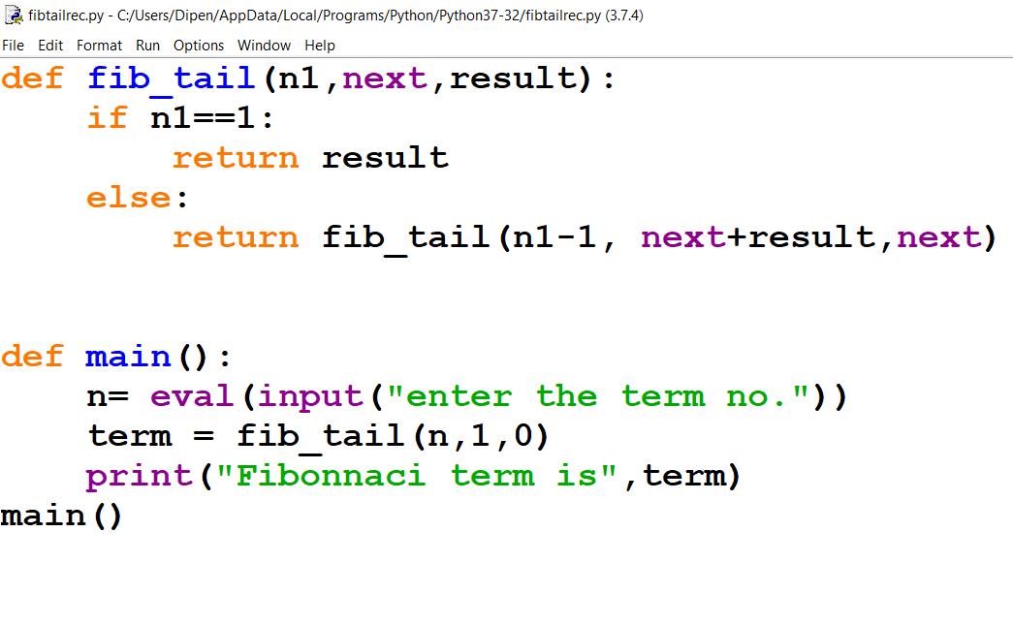
Normal Recursion Vs Tail Recursion
(Fibonacci function)

Slide 10
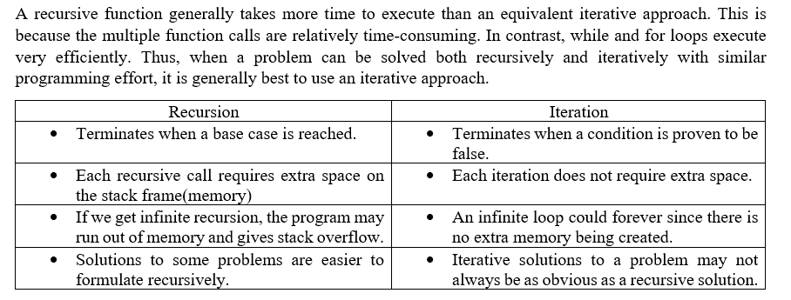
Recursion vs iteration

Slide 11
Important points about Recursion
Recursive algorithms have two types of cases, recursive cases and base cases.
​Every recursive function case must terminate at a base case.
​Generally, iterative solutions are more efficient than recursive solutions [due to the overhead of function calls].
A recursive algorithm can be implemented without recursive function calls using a stack, but it’s usually more trouble than its worth. That means any problem that can be solved recursively can also be solved iteratively.
​For some problems, there are no obvious iterative algorithms.
Some problems are best suited for recursive solutions while others are not.

Slide 12
Example Algorithms of Recursion
Fibonacci Series, Factorial Finding
​Merge Sort, Quick Sort
​Binary Search
Tree Traversals and many Tree Problems: InOrder, PreOrder PostOrder
​Graph Traversals: DFS [Depth First Search] and BFS [Breadth First Search]
​Dynamic Programming Examples
Divide and Conquer Algorithms
Towers of Hanoi
Backtracking

